Slide 1
Sensitivity analysis
2023. 12. 06
SMEET LAB

Slide 2
Sensitivity analysis
Why Select a variable
DNN may not need to choose input variables. Because the coefficients of unnecessary variables will converge to zero. However, selecting many variables to make the model increases the computational cost of estimation
So, We need to find sensitivity input variable for reducing computing load

Slide 3
Sobol’s method
Variance Based analysis
As also known Sobol’s method
Using Decomposition of Variance
Can measure sensitivity across the whole input space

Slide 4
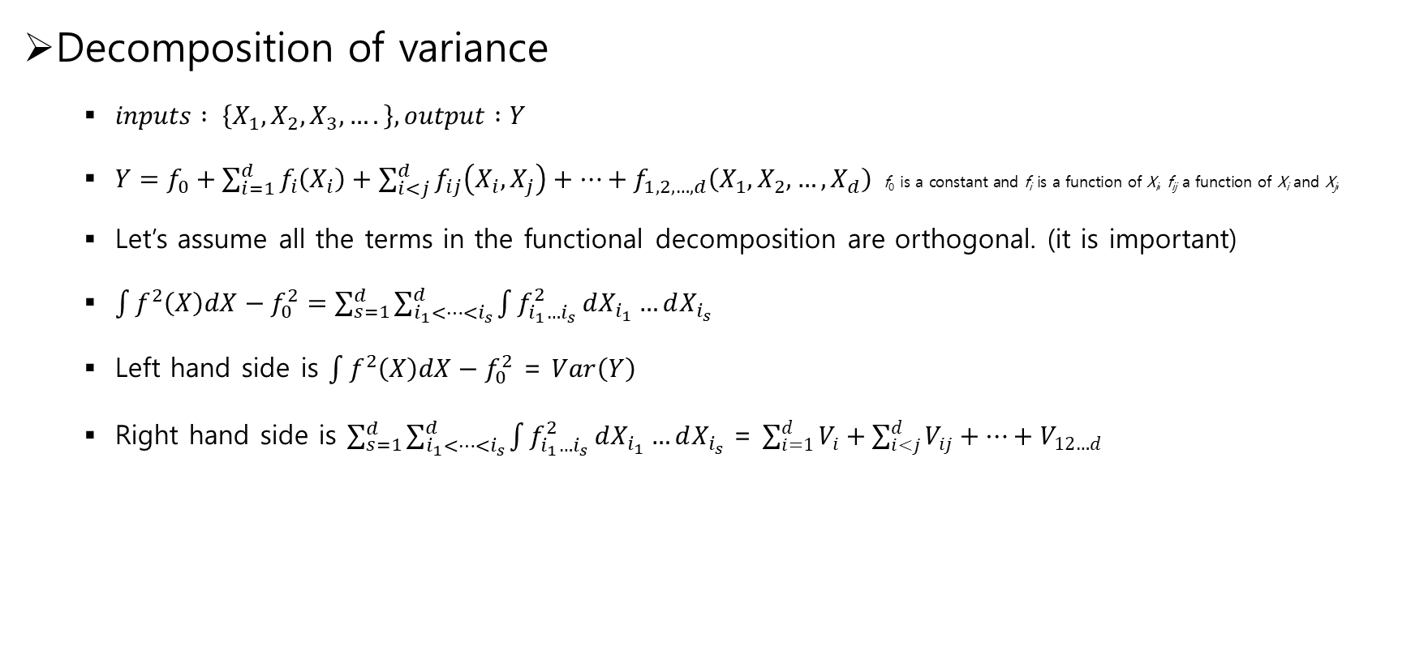
Sobol’s method
Decomposition of variance
$inputs : \left\{X_{1},X_{2},X_{3},….\right\}, output :Y$
$Y=f_{0}+\sum_{i=1}^{d}{f_{i}\left(X_{i}\right)}+\sum_{i<j}^{d}{f_{ij}\left(X_{i},X_{j}\right)}+⋯+f_{1,2,…,d}\left(X_{1},X_{2},…,X_{d}\right)$ $\text{f}\text{0} \text{is} \text{a} \text{constant} \text{and} \text{f}\text{i} \text{is} \text{a} \text{function} \text{of} \text{X}\text{i}\text{, }\text{f}\text{ij} \text{a} \text{function} \text{of} \text{X}\text{i} \text{and} \text{X}\text{j}\text{,}$
Let’s assume all the terms in the functional decomposition are orthogonal. (it is important)
$\int{f^{2}\left(X\right)dX}−f_{0}^{2}=\sum_{s=1}^{d}{\sum_{i_{1}<…<i_{s}}^{d}{\int{f_{i_{1}…i_{s}}^{2}}}}dX_{i_{1}}…dX_{i_{s}}$
Left hand side is $\int{f^{2}\left(X\right)dX}−f_{0}^{2}$ = $Var\left(Y\right)$
Right hand side is $\sum_{s=1}^{d}{\sum_{i_{1}<…<i_{s}}^{d}{\int{f_{i_{1}…i_{s}}^{2}}}}dX_{i_{1}}…dX_{i_{s}}$ = $\sum_{i=1}^{d}{V_{i}}+\sum_{i<j}^{d}{V_{ij}}+⋯+V_{12…d}$

Slide 5
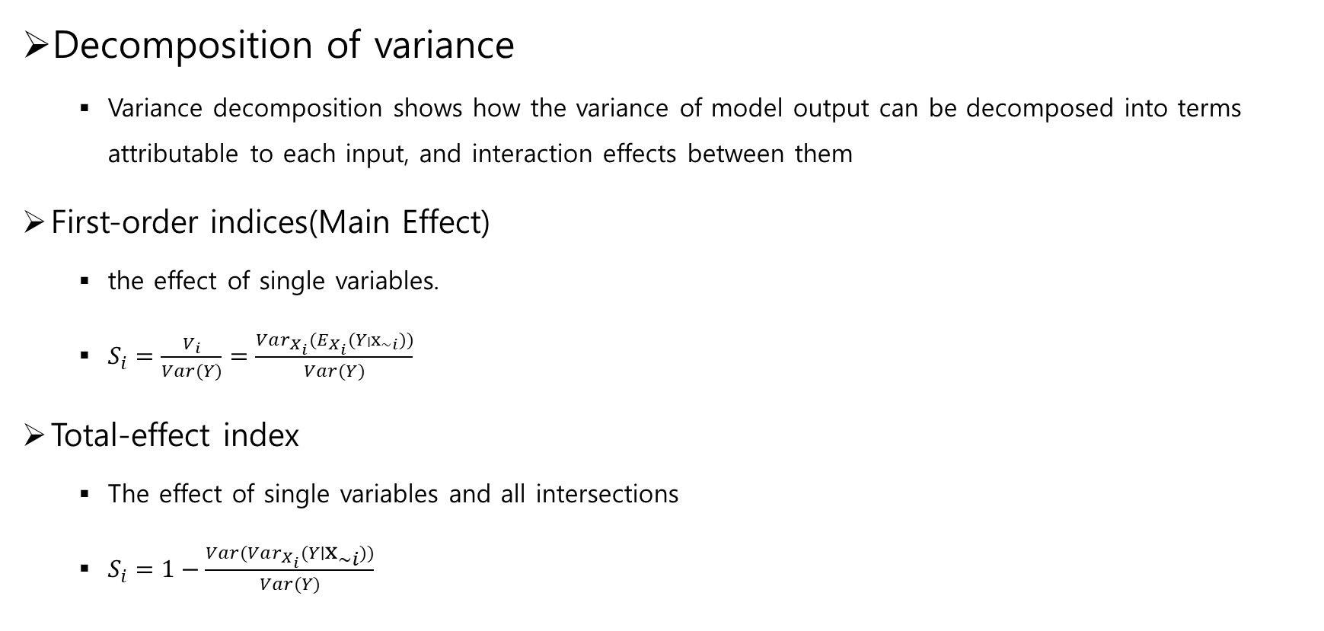
Sobol’s method
Decomposition of variance
Variance decomposition shows how the variance of model output can be decomposed into terms attributable to each input, and interaction effects between them
First-order indices(Main Effect)
the effect of single variables.
$S_{i}=\frac{V_{i}}{Var(Y)}=\frac{Var_{X_{i}}(E_{X_{i}}(Y∣x_{\sim i}))}{Var(Y)}$
Total-effect index
The effect of single variables and all intersections
$S_{i}=1−\frac{Var(Var_{X_{i}}(Y∣x_{\sim i}))}{Var(Y)}$

Slide 6

Sobol’s method
Example of Calculate $Var_{X_{i}}(E_{X_{i}}(Y∣x_{\sim i}))$
When X₁ is 1, the mean of the corresponding Y values, 11.33
X₁ | X₂ | X₃ | Y
1 | 2 | 3 | 10
1 | 3 | 1 | 11
1 | 4 | 5 | 13
2 | 2 | 2 | 15
2 | 3 | 1 | 14
2 | 1 | 4 | 16
… | … | … | …

Slide 7

Sobol’s method
Example of Calculate $Var_{X_{i}}(E_{X_{i}}(Y∣x_{\sim i}))$
When X₁ is 2, the mean of the corresponding Y values, 11.33
X₁ | X₂ | X₃ | Y
1 | 2 | 3 | 10
1 | 3 | 1 | 11
1 | 4 | 5 | 13
2 | 2 | 2 | 15
2 | 3 | 1 | 14
2 | 1 | 4 | 16
… | … | … | …

Slide 8
Sobol’s method
The Difficult situation of usage
The dataset I have is collected using sensor data, not control values. Therefore, it's not certain that it contains the same values.
So I won’t use this method

Slide 9
Boruta
Boruta Algorithm
Boruta Algorithm is finding the most important features in a dataset
Use Random forest method.
Advantage
Robustness
Non-parametric
Disadvantages
Computational intensity

Slide 10
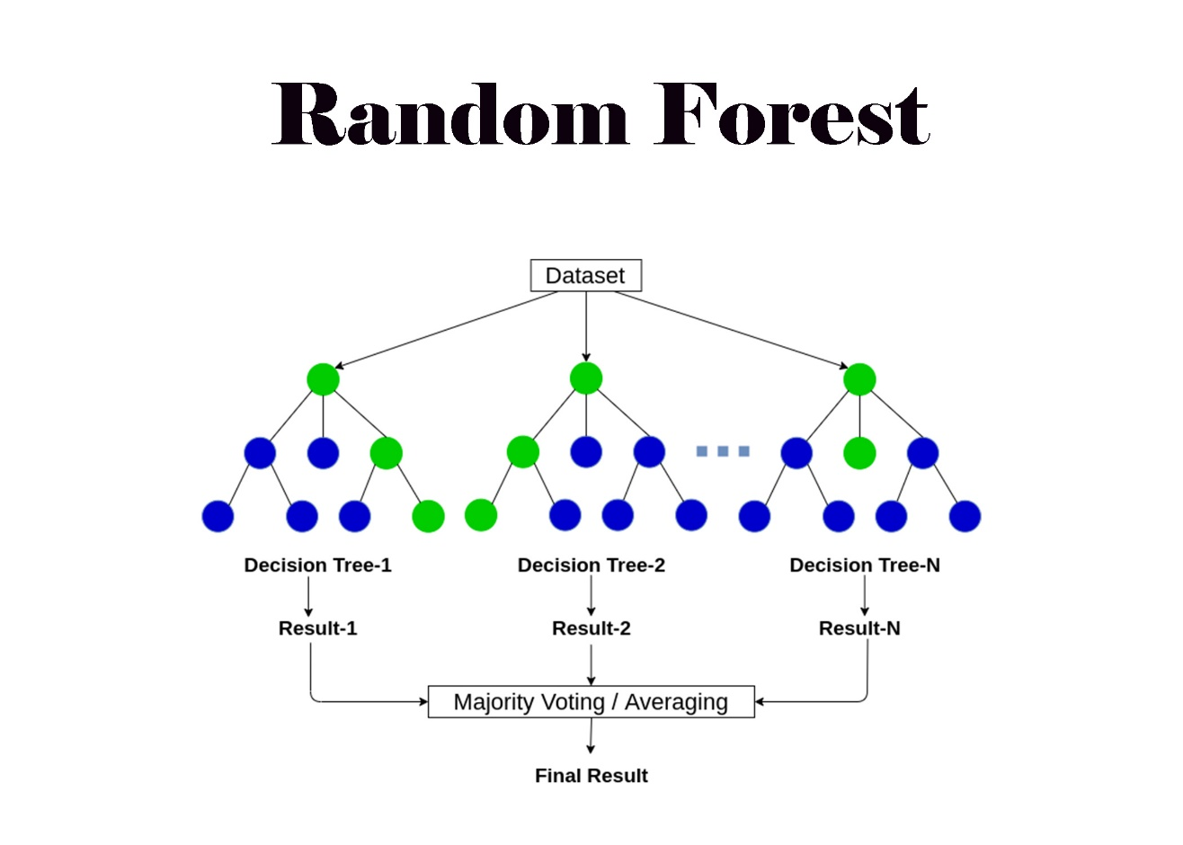
Boruta
Random Forest
Derived from Decision Tree
Added Ensemble

Slide 11
Boruta
Boruta
Added Shadow variables.
Train Random Foreset
Extract importances
Determine the values that have lower importance than shadow variables

Slide 12
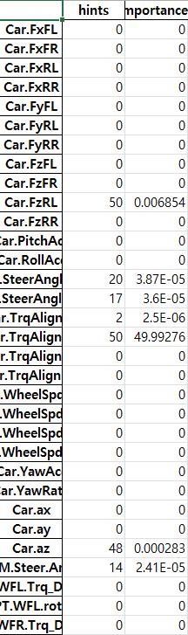
Boruta
Result
Input : random select , output : FyFL(Front Left Wheel y axis Force)

Slide 13
My Model
Method
Use Boruta
Visualization the select data.
Variables
Gathering Data using CARMAKER
Data is gathered by sensor Data and control Data that can achieve
Sensor Data: Data from IMU, Wheel speed sensor
Control Data : steering angle, Motor Torque

Slide 14
Q&A

Slide 15
THANK YOU!

